Slide 1
“SandStorm” –attack
“The answer problem is not in the box, it’s in the band.” – AntiTrust
Dennis Rand

Slide 2
Background
”SandStorm” –attack
“The answer problem is not in the box, it’s in the band.” – AntiTrust
Spare-time project
Still work in progress
Had just completed a pentest and was fixing bug in a sandbox application.
Research and writeup by Dennis Rand

Slide 3
Background
”SandStorm” –attack
“The answer problem is not in the box, it’s in the band.” – AntiTrust
The first generation of Sandbox technologies for analyzing malware was very strict and run in closed environments, where the actual malware execution often was done on emulated OS’s and services rather than on real systems.
Today we execute on virtual or real hardware and full OS’s to gain the best information on the binary.
Research and writeup by Dennis Rand

Slide 4
Sandbox implementations
”SandStorm” –attack
“The answer problem is not in the box, it’s in the band.” – AntiTrust
Research and writeup by Dennis Rand

Slide 5

What is ”SandStorm”
”SandStorm” –attack
“The answer problem is not in the box, it’s in the band.” – AntiTrust
The “SandStorm” attack is a concept of attacking sources on the internet by using various online systems, such as unknown binary analysis system.
Somewhere within the red circle is the grain which is the “SandStorm” binary.
Research and writeup by Dennis Rand

Slide 6
Sources of attacks
”SandStorm” –attack
“The answer problem is not in the box, it’s in the band.” – AntiTrust
Online Antivirus scanners (Jump station)
Interesting since the samples they scan are widely distributed, meaning that the SandStorm –attack could/will be executed from several none public sandboxes.
Mail submission (Jump station)
Also a jump station to possible none-public sandboxes.
Online binary analysis systems
PE → Microsoft
ELF → *nix
APK → Android
CCI → iOS
Research and writeup by Dennis Rand

Slide 7
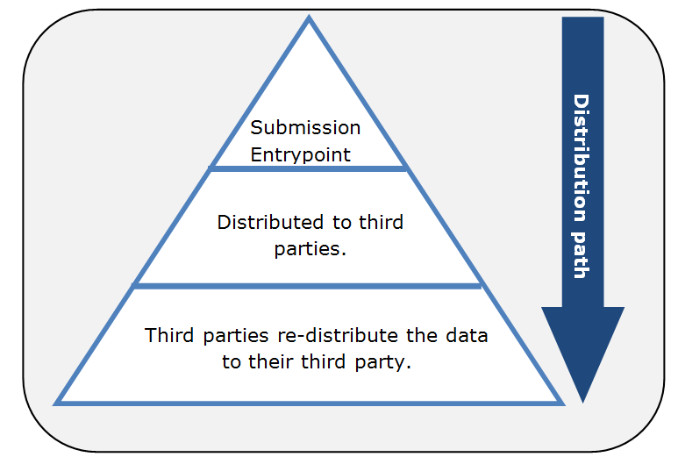
Entry points
”SandStorm” –attack
“The answer problem is not in the box, it’s in the band.” – AntiTrust
12 → Online sandbox systems
15 → Online AV submission systems
19 → Mail/URL submissions
Research and writeup by Dennis Rand

Slide 8
Stand-alone - Sandbox
”SandStorm” –attack
“The answer problem is not in the box, it’s in the band.” – AntiTrust
It is a “fire-and-forget” type of attack. This means that unless there is a specific IPS rule to stop the specific attack it will be successful.
Binary distributed to analysis solution.
Execute exploit towards the target
Research and writeup by Dennis Rand

Slide 9
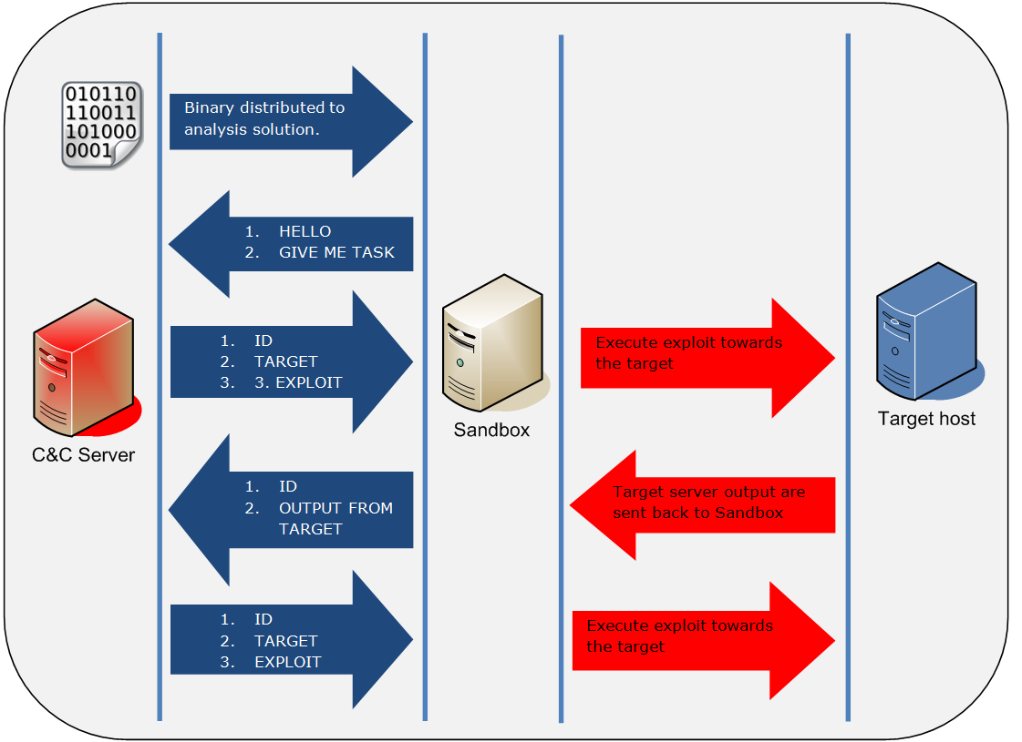
Distributed - Sandbox
”SandStorm” –attack
“The answer problem is not in the box, it’s in the band.” – AntiTrust
The second way is to build a distributed scanning/attack vector where the binary is only acting as a “Relay” meaning it will fetch information on what to do from a Command & Control server that will provide:
Target
Exploit
Research and writeup by Dennis Rand

Slide 10
Test cases
”SandStorm” –attack
“The answer problem is not in the box, it’s in the band.” – AntiTrust
Loop connection request every 10 seconds.
Loop connection request every second
Stand-alone attack (SQL injection)
Distributed attack (18 attacks/exploits)
Research and writeup by Dennis Rand

Slide 11
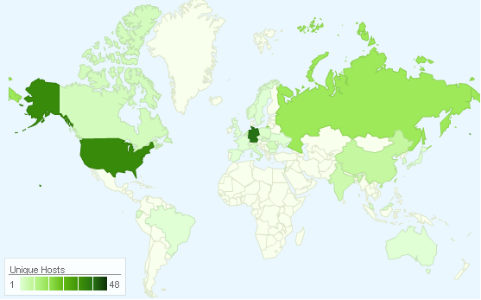
Testcase 1 – Anyone home
”SandStorm” –attack
“The answer problem is not in the box, it’s in the band.” – AntiTrust
173 unique IP’s were seen connecting back to the C&C server, distributed over 28 different geographical locations.
The server received 9316 connections
Research and writeup by Dennis Rand

Slide 12
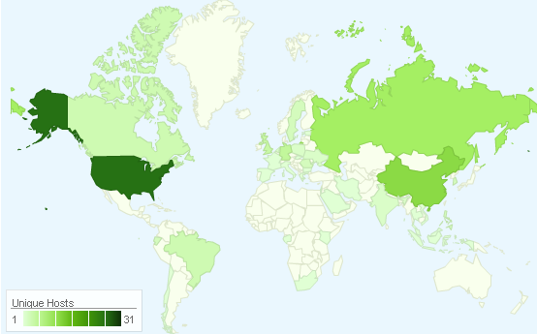
Testcase 2 – Do I have to repeat myself
”SandStorm” –attack
“The answer problem is not in the box, it’s in the band.” – AntiTrust
During the run 131 unique IP’s were seen connecting back to the C&C server, distributed over 35 different geographical locations.
Server received 7336 connections
Research and writeup by Dennis Rand

Slide 13
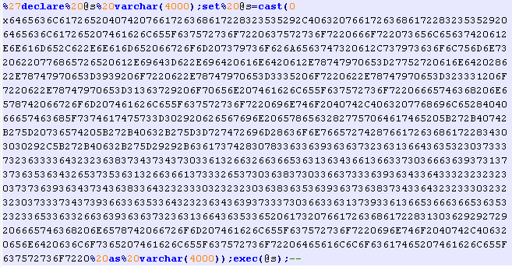
Testcase 3 – Fast in fast out
”SandStorm” –attack
“The answer problem is not in the box, it’s in the band.” – AntiTrust
The exploit send in “Binary test case 3” is based on a Mass SQLi attack from the Asprox worm that was mentioned and described on ISC SANS back in 2008.
Research and writeup by Dennis Rand

Slide 14
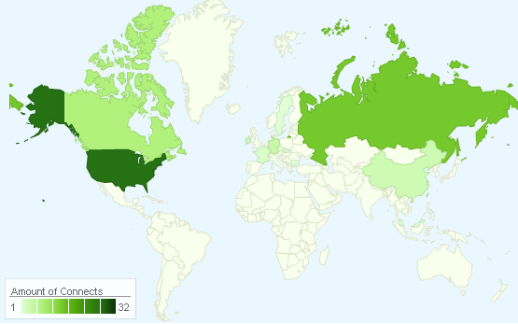
Testcase 3 – Fire and forget
”SandStorm” –attack
“The answer problem is not in the box, it’s in the band.” – AntiTrust
14 binaries were executed 81 times from 43 unique IP’s
80 unmodified SQLi attacks, was either executed through the binary or a replay attack, and 1 modified SQLi attack where the request sent to the server was changed, but still not filtered out the attack.
Research and writeup by Dennis Rand

Slide 15
Testcase 4 – What is thy bidding, my master
”SandStorm” –attack
“The answer problem is not in the box, it’s in the band.” – AntiTrust
ID # | Exploit name | Exploit sources
1 | Asprox SQL injection (Modified) | http://isc.sans.edu/diary.html?storyid=4565
2 | Apache < 1.3.37, 2.0.59, 2.2.3 (mod_rewrite) Remote Overflow | CVE-2006-3747
4 | Axous 1.1.0 SQL Injection Vulnerabilitiy | http://www.1337day.com/exploits/18141
5 | Wordpress Zingiri Web Shop Plugin <= 2.4.0 Multiple XSS | http://www.1337day.com/exploits/18135
6 | Joomla com_videogallery LFI | http://www.1337day.com/exploits/18125
7 | joomla component (com_jomtube) SQL injection Vulnerability | http://www.1337day.com/exploits/18033
8 | GENU CMS SQL Injection Vulnerability | http://www.1337day.com/exploits/17984
9 | Newscoop 3.5.3 RFI | http://www.1337day.com/exploits/18071
10 | VMware Update Manager Directory Traversal | http://www.1337day.com/exploits/16861
11 | User-agent SQLi test | Testing SQLi in header information
12 | X-Forward SQLi header test | Testing SQLi in header information
13 | SQLi - iFrame injections attack from 2011 (Unmanipulated) | http://www.issahawaii.org/download.cfm?ID=31551
14 | PHP Source code disclosure | CVE-2012-1823 PHP Source code disclosure
15 | CVE-2012-1823 - PHP CGI Argument Injection Remote Exploit | http://www.1337day.com/exploits/18314
16 | XSS img src | http://ha.ckers.org/xss.html
17 | IMG XSS UTF-8 encoded | http://ha.ckers.org/xss.html
18 | IMG XSS Embedded newline | http://ha.ckers.org/xss.html
Research and writeup by Dennis Rand

Slide 16
Testcase 4
”SandStorm” –attack
“The answer problem is not in the box, it’s in the band.” – AntiTrust
The numbers below are based on the exploits executed and where the binary connected back to the C&C with a result.
I noticed that multiple of the exploits were later replayed towards the
target host(s), without having
communicated with the C&C
first.
ID | Executions
1 | 136
2 | 123
4 | 119
5 | 115
6 | 113
7 | 111
8 | 111
9 | 111
10 | 111
11 | 111
12 | 103
13 | 99
14 | 98
15 | 93
16 | 93
17 | 34
Research and writeup by Dennis Rand

Slide 17
PRO’s and CON’s → Filtering
”SandStorm” –attack
“The answer problem is not in the box, it’s in the band.” – AntiTrust
Setting up a Sandbox without any EPS in place
PROs | CONs
Allowing the executable(s) to do all outbound connections. | Allowing the executable to perform attacks on internet connected hosts.
 | Worm based code executed on non-protected sandboxes could result in spreading the threat.
Setting up a Sandbox with EPS in place
PROs | CONs
The Sandbox system should not be able to be abused for targeting internet connected systems | Dissallowing specific type of network data could mean not getting full insight into the executable
 | Malware samples can use this to identify sandboxes, and thereby execute other behavior, not related to actual in-the-wild behavior.
EPS (Extrusion Prevention Systems).
Research and writeup by Dennis Rand

Slide 18
Questions ?
”SandStorm” –attack
“The answer problem is not in the box, it’s in the band.” – AntiTrust
Me to you
You to me
Research and writeup by Dennis Rand

Slide 19
”SandStorm” –attack
“The answer problem is not in the box, it’s in the band.” – AntiTrust
Research and writeup by Dennis Rand

Slide 20
”SandStorm” –attack
“The answer problem is not in the box, it’s in the band.” – AntiTrust
Research and writeup by Dennis Rand

